Slide 1
Practical Steps for Increasing Openness and Reproducibility
[your name]
[your affiliation]

Slide 2

COMMUNITY
METASCIENCE
INFRASTRUCTURE
Notes:
so, now that I’ve hopefully convinved you that analysis plans, pre-registration, and clearly distinguishing between confirmatory and exploratory analyses are important things to do, how do you actually implement these changes, and what is out there to help you make these changes? Talk is cheap, and researchers are very busy people who often have workflows that they really like, so how can we make these changes in a way that is the least disruptive and time consuming as possible?
At the COS, we’re interested in finding ways to support researchers in implementing better research practices and to increase the openness, integrity, transparency, and the reproducibility of scientific research.
We have three main areas of operation. We build free, open source infestructure to support open research practices, building a community that helps to incentives good practices, and performing meta-science research to investigate who changes in scientific practice affect publishing, results, and scientific findings.
overall, stress that it’s community driven, all free, all open source, we have no intellectual property, eager to collaborate with anyone who shares same values and vision (scientisits, associations, governmetn, publishers, everyone)
this whole esction shoudl be an invetation and ploy to get people to ask to work wiht us (in addition to people wanting to use our services)
how to pitch my new services (maybe do that as the closer) - 2 to 3 slides about the services that I bring to the COS (what I can uniquely bring to the table - this is completely a sales pitch, but a needed sales pitch) - what I do is more about making research more reproducable, I’m year round, I can do remote sessions, group sessoins, or I can come to you, your lab (let us know what you want, what are you not getting from what’s being offered elsewhere right now)
- could collabore with university stats labs to help them incorporate some of the reproducible stuff we do into the consulting they give (this is our mission, this is specifically what we’re suppose to be doing)
Talking points:
2) We have three main areas of activity to address the problems with incentives and personal barriers which we mentioned previously: 1) enabling metascience research, 2) building community, and 3) developing infrastructure in the form of OSF.
details to have on hand
Change the incentive structure without creating more hurdles
Increase accountability to self and others
Increase discoverability of materials, data, and workflow
Respect existing workflow
infrastructure - OSF
major arm of COS
Workflow software to help researchers organize, archive, and connect
Built flexibly so nothing is mandated: tools to support your individual workflow
provides altmetrics
community: transparent practices
Offer a place to use and improve programming skills while making an important impact
Designed badges to recognize open practices: indicates that they are valued; offer these freely to any journal or organization that wants to sign on
Idea is to foster a diverse and inclusive community that discusses and improves its own practices
we will provide the technical support and venue: we will connect you and you do whatever you’re best at
metascience
collaborative projects investigating the replicability of current scientific research: What is the problem, exactly? (RP:P, RP:CB, Wysktra-replicability in social science)

Slide 3
Scientific Ideals
- Innovative ideas
- Reproducible results
- Accumulation of knowledge
Notes:
3) accumulate knowledge: science as a whole is slowly accumulating knowledge. Individual studies are pieces of evidence that may support or undermine a given theory, and overtime these individual pieces of evidence should accumulate into a greater understanding of what theories and phenomena are true, what is really going on in teh world around us?
We want to believe that science is accumulating knowledge about interesting, real phenomena
But is that really the case? How much can we trust the knowledge that has been accumulated based on published findings?

Slide 4
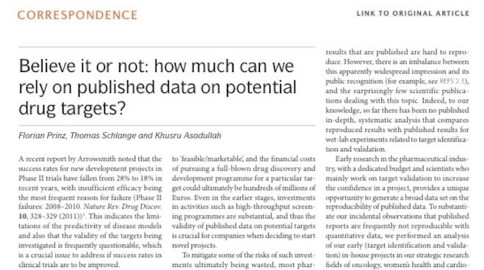
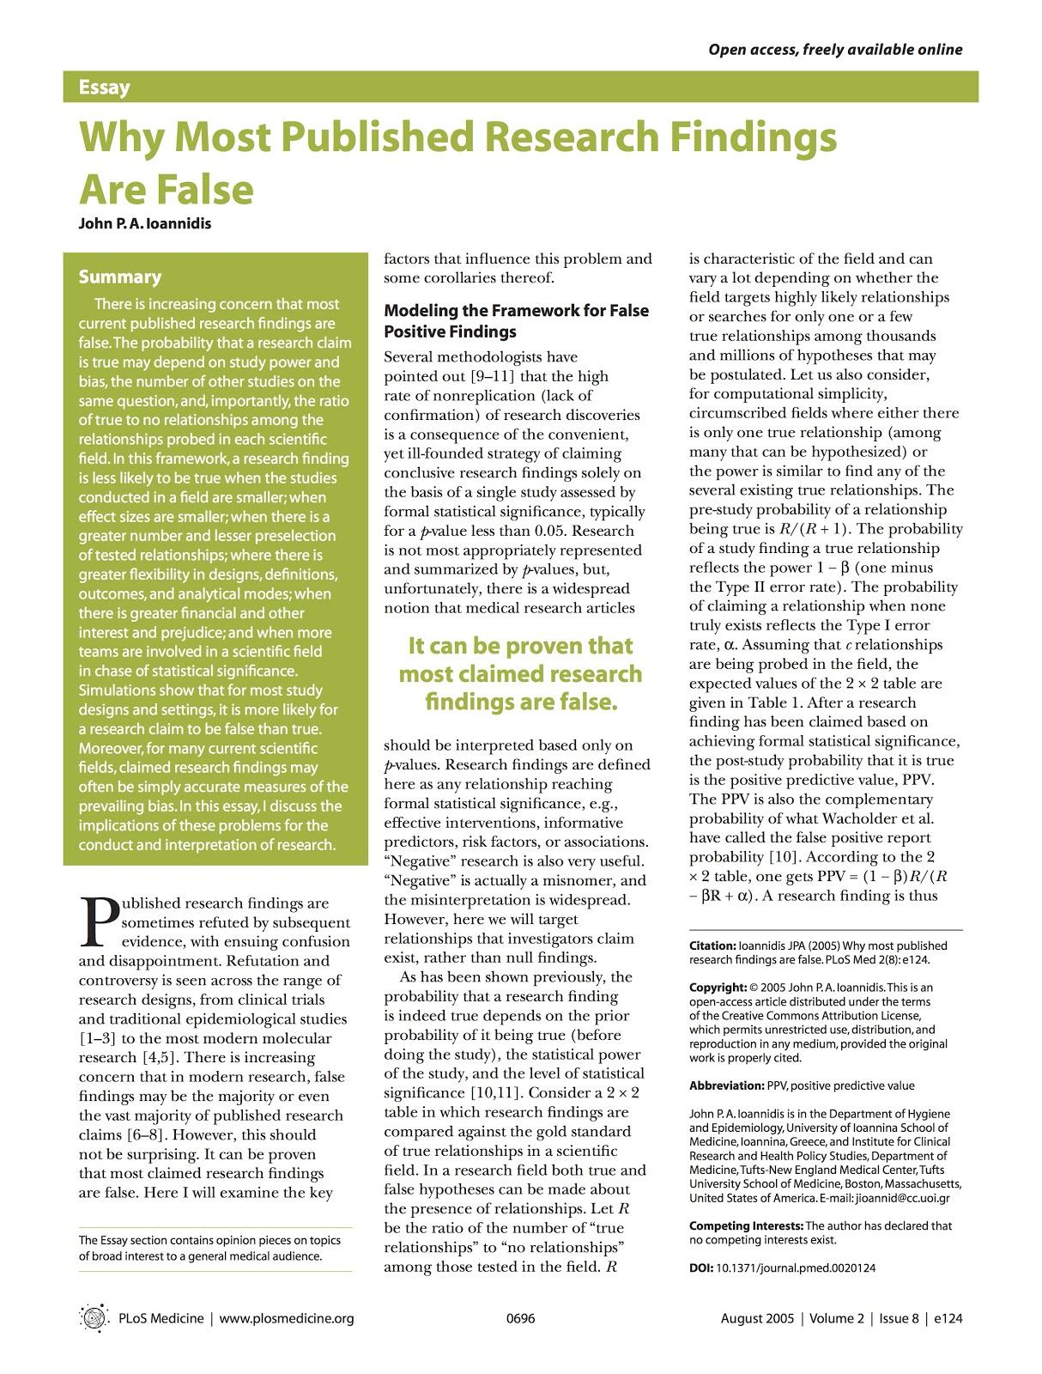
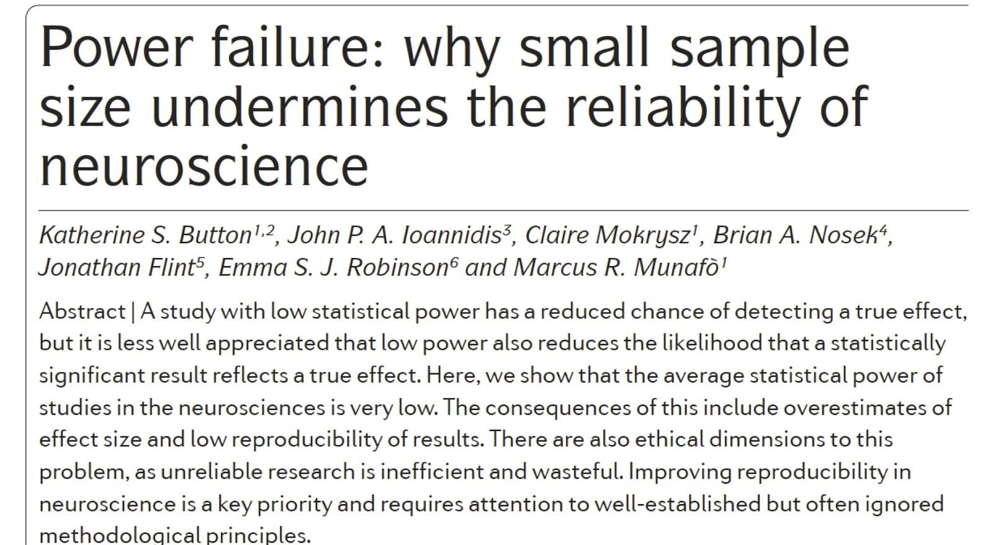
Notes:
Unfortunately, it has become apparently over the last few years that perhaps the answer to that question is not all that much.
Now, there have been some very prominent cases in the past few years of outright fraud, where people have completely fabricated their data, but I’m not talking about those case. What I’m talking is the general sense that many scientific findings in a wide variety of fields don’t replicate, and that the published literature has a very high rate of false-positives in it.
So if a large proportion of our published results aren’t replicable, and are potential false positives, Are we actually accumulating knowledge about real phenomena? I would suggest that hte answer to this question is ‘no’, or at least we haven’t accumulated as much knowledge as we would like to believe.

Slide 5
What is reproducibility?
Computation Reproducibility:
If we took your data and code/analysis scripts and reran it, we can reproduce the numbers/graphs in your paper
Empirical Reproducibility:
We have enough information to rerun the experiment or survey the way it was originally conducted
Replicability:
We use your exact methods and analyses, but collect new data, and we get the same statistical results

Slide 6
Publish report
Search and discover
Write report
Develop idea
Interpret findings
Design study
Analyze data
Acquire materials
Store data
Collect data
Notes:
Workflow – level of abstraction that is shared across areas of scholarly inquiry, particularly the sciences
Functions that support that workflow

Slide 7
Why should you care?
Your own work less efficient
Hard to build off our own work, or work of others in our lab
We may not have the knowledge we think we have
Hard to even check this if reproducibility low

Slide 8
Open Science Framework
https://osf.io
Notes:
contact@cos.io
or my email if you want to talk to an actual person
also mention videos on website
all our data stored on amazon web services S3; security practices: all cloud storage, security measures in place (physical security for physility, who gets access to databases adn servies, so very limited who gets access to data about users (about you, about your behavior, about your private projects); we encrypt our data, measures in place to find if hacking is going on; sensitive confidential data, don’t put it there, because we aren’t currently complient with those requirment (currently working on a work around for HIPPA) but we would like to explore this with any who has expertise on this

Slide 9
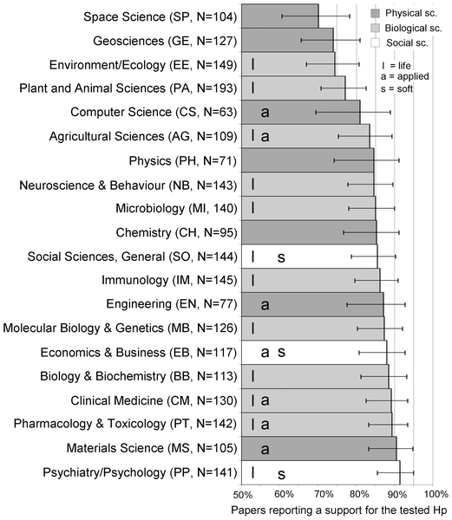

Figure 1. Positive Results by Discipline.
Fanelli D (2010) “Positive” Results Increase Down the Hierarchy of the Sciences. PLoS ONE 5(4): e10068. doi:10.1371/journal.pone.0010068
http://127.0.0.1:8081/plosone/article?id=info:doi/10.1371/journal.pone.0010068

Slide 10
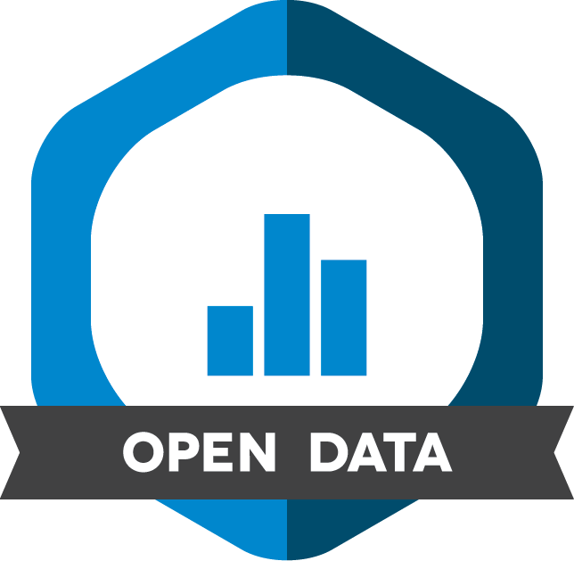
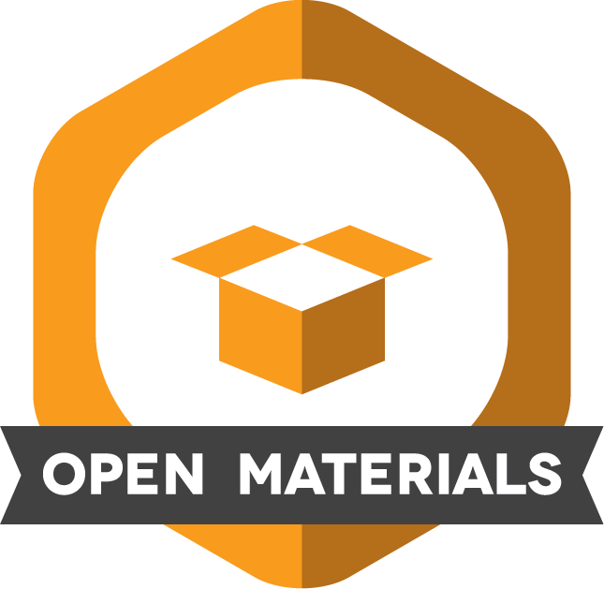
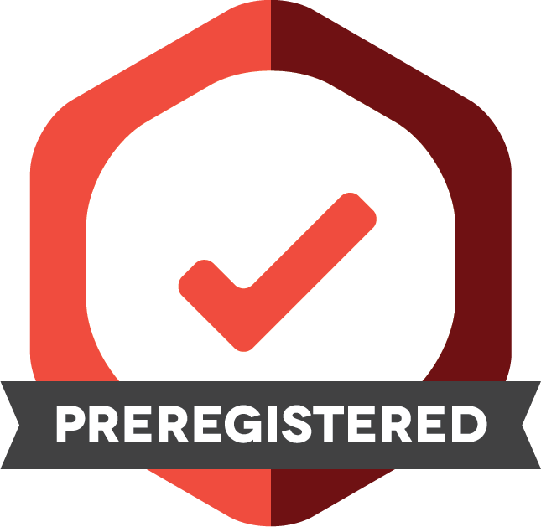
Badges for Open Practices
Notes:
low risk, low cost rewards (who doesn’t love a gold star) - this isn’t a requirement, it’s a prize that’s completely voluntary (extra reward for something you are already doing anyway if you buy what I said about pre-analysis plans)
Talking points:
1) As an example of a community project, we are working with a diverse group of organizations to promote the adoption of badges for open practices. Early examples include open data, open materials, and preregistration.
2) These are not domain specific, organizations don’t have to pay to use them, organizations don’t have to use them all. They might be used by journals.
3) This a very low cost, low effort, low risk incentive for promoting good open science practices.

Slide 11

Notes:
Also have an initiave to get journals ot adopt review of pre-registered reports of publications, so not even publication decisions are data dependent, but are made instead on the solidness of theory, study design, and analyses

Slide 12
Recap
Begin documentation at study inception
Register study designs
Save & document data and analysis
Be open with your process and your study materials

Slide 13
Where to get help:
Reproducible Research Practices?
stats-consulting@cos.io
The OSF?
support@osf.io
Have feedback for how we could support you more?
contact@cos.io
feedback@cos.io

